Slide 2
Learning about the Christian faith
Teaching you today: Mrs Jordan/ Mrs Bastable
Watford Schools Trust

Slide 3
The Bible story of David and Goliath
Teaching you today: Mrs Jordan/Mrs Bastable
Watford Schools Trust

Slide 18
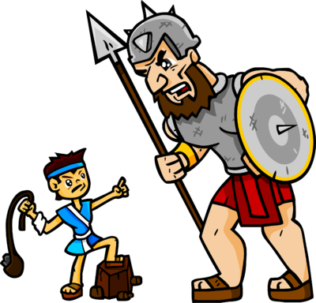
Only a boy named David, only a little sling Only a boy named David, but he could pray and sing Only a boy named David, only a rippling brook Only a boy named David, but five little stones he took. And one little stone went in the sling
And the sling went round and round
And one little stone went in the sling
And the sling went round and round
And round and round, and round and round, and round and round and round
And one little stone went into the air……….
And the giant came tumbling down!

Slide 19
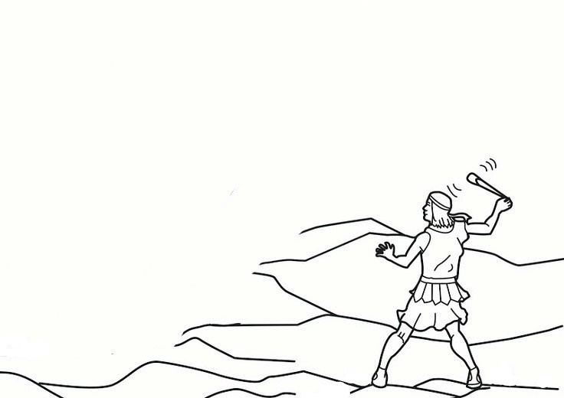
Name:……………………………………….. Date………………………………
L.O. To explore the Bible Story of David and Goliath and what it tells about God.
To do: Draw Goliath
Cut out 5 stones from black paper and stick these on the sheet.
Draw Goliath in the empty space
Write a sentence about what happened when David met Goliath
Cut out 5 stones and stick them onto the worksheet
Colour in your picture
……………………………………..…………………………………………………………………………………………………………………………………………………………………………………………………………………………………………
………………………………………………………………………………………………………………………………………………………………………………………………………………………………………………………………………………...

Slide 20
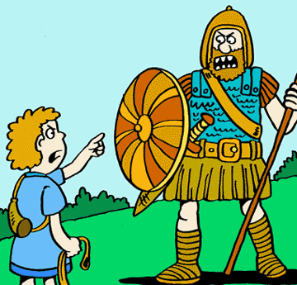
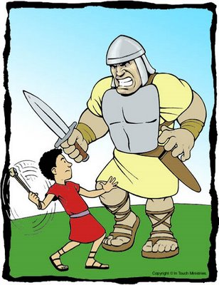

Slide 22
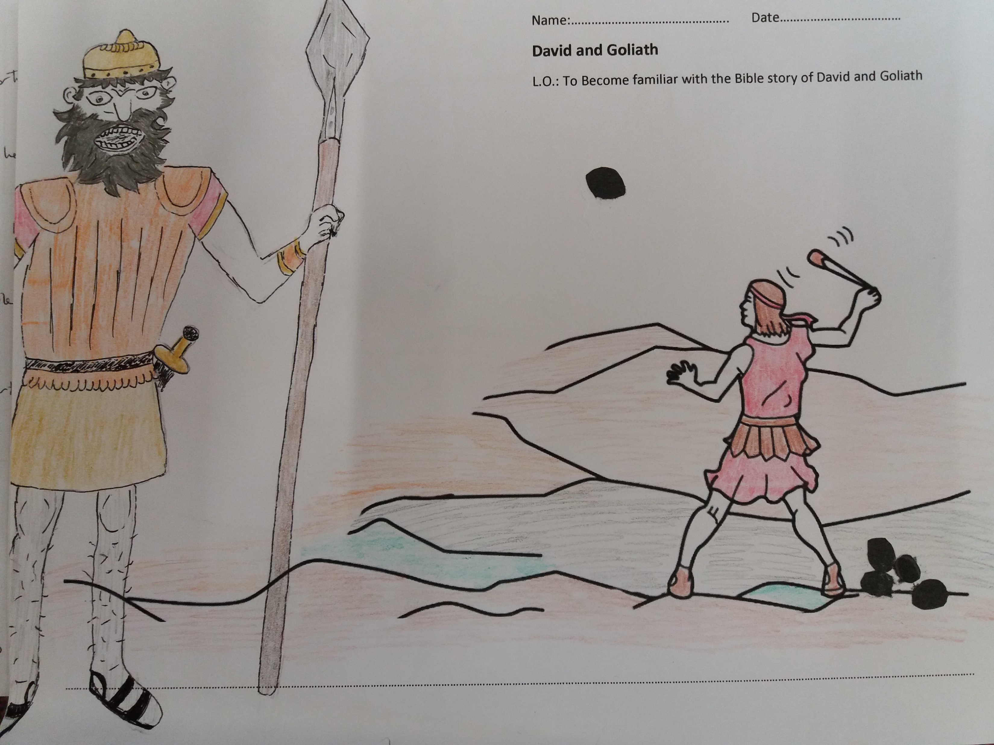

Slide 23
